Slide 1
Pre-loaded DMEK Tissue
Shahzad Mian, M.D., University of Michigan
Lauren Johnson, Eversight Director Training & Education

Slide 2
DMEK vs. DSEK

Slide 3
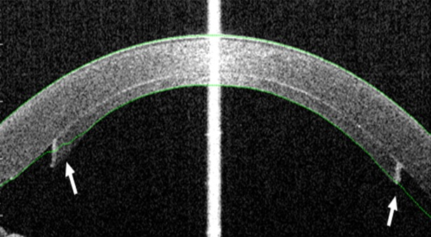
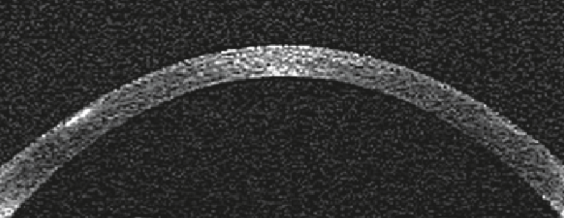
DSEK DMEK
Endothelial dysfunction/corneal edema
Endothelial Keratoplasty
Tissue additive
Tissue neutral

Slide 4
DMEK
Over the past 3 years, there has been a sharp increase in the number of DMEK surgeries being performed
37.6%
63.8%
88.2%
103.5%
2015 Eye Banking Statistical Report. Eye Bank Association of America. 2016. Washington DC.
Notes:
2012—748, 2015—4,694; 2016 – 6459 (37.6%) increase

Slide 5
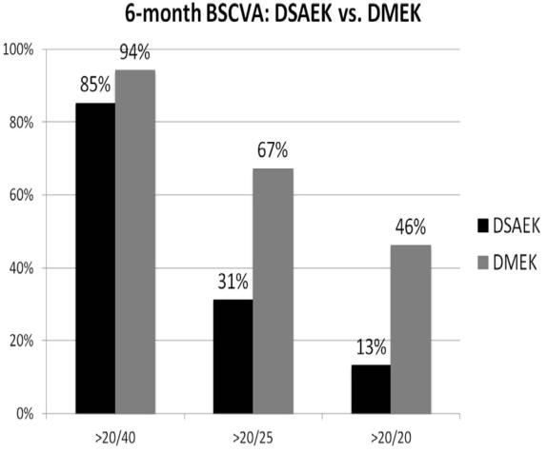
DMEK – improved visual acuity
N=200; First 100 cases of each procedure (retrospective case series).
Hamzaoglu EC, Straiko MD, Mayko ZM, Sáles CS, Terry MA. Ophthalmology. 2015;122(11):2193-9.
Notes:
Most gains of DMEK compared to DSAEK seen in the patients with visual potential of 20/25 or better

Slide 6
DMEK – Reduced rejection risk
Anshu A, Price MO, Price FW. Ophthalmology. 2012;119(3):536-40.

Slide 7
DMEK
DMEK still only accounts for 23% of all EK procedures performed in the US
Notes:
2012—748 DMEK 23k DSAEK
2015—5k DMEK, 27k DSAEK
2016 – 65K DMEK, 21,868 DSAEK

Slide 8
DMEK
DMEK is a technically difficult surgery
New surgical maneuvers
DMEK graft tissue is very fragile
Minimize manipulation
Notes:
DMEK numbers are lagging far behind DSAEK for multiple reasons. DMEK is difficult surgery. Difficult due to new/different surgical maneuvers. Will address the difficulty of tissue preparation/manipulation.
Also, unclear benefit in some peoples eyes when compared to UT-DSAEK (this presentation will not address that).

Slide 9
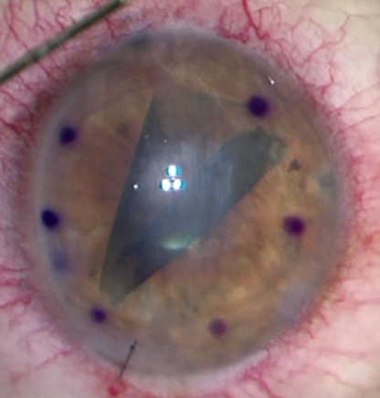
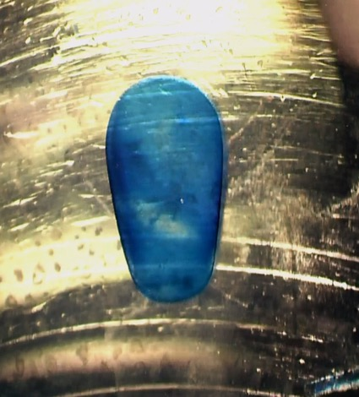
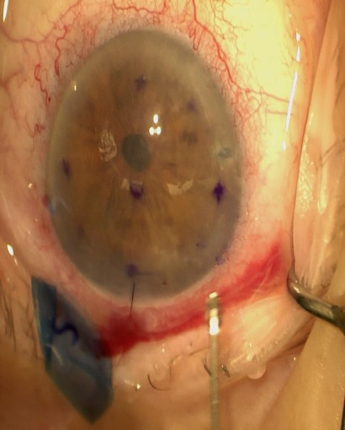
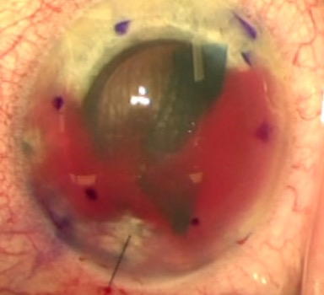
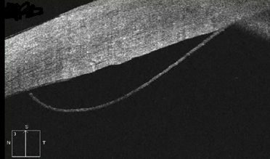
So why don’t we do DMEK on every case?
Notes:
Technically challenging. Grafts easily expulse, hyphemas not forgiving, detachments, tissue can be unpredictable with loading, preparation can be variable

Slide 10
DMEK
Optimal tissue delivery
Prestripped and pretrephined
Eye-bank preparation of prestripped tissue has aided in acceptance and increased conversion to DMEK
Similar to precut DSAEK nearly a decade ago

Slide 11
DMEK
Optimal tissue delivery
Prestripped and pretrephined
Preloaded
Container type
Trypan staining
Notes:
Preloaded DMEK approaches are being proposed as a way to streamline the procedure
How Trypan blue staining will be introduced to the tissue prior to surgery has not been well evaluated to date.

Slide 12
PURPOSE
To determine the endothelial safety of pre-staining DMEK grafts with Trypan Blue prior to preloading
Wolle M, DeMill D, Woodward M, Mian, S. The Endothelial Safety of Using Preloaded Descemet Membrane Endothelial Keratoplasty Graft. Cornea (in press)

Slide 13
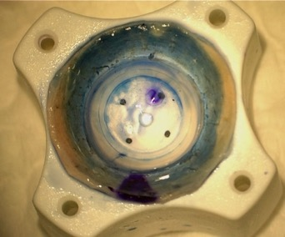
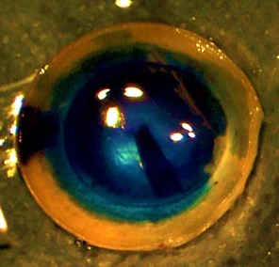
METHODS
Twenty seven cadaveric corneas
Prepared for DMEK using a standardized technique
Experienced DMEK eye bank technician
Notes:
Grafts: separated from the underlying stroma using manual peeling, S stamp for orientation, laid back down, and stored in Optisol GS.
Grafts stained with Trypan blue for 30 seconds and punched with a new 7.5mm trephine without suction by the surgeon

Slide 14
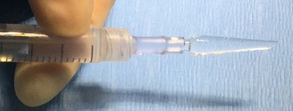
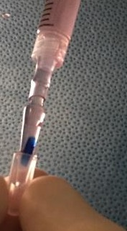
METHODS
Twenty seven cadaveric corneas
Prepared for DMEK using a standardized technique
Loaded in Straiko Modified Jones Tube injector (Gunther Weiss Scientific Glass, Portland, OR)
Filled with Optisol GS
Notes:
The modified Jones tube was attached to a 3cc syringe, with 14 fr NG tubing connector, and filled with Optisol

Slide 15
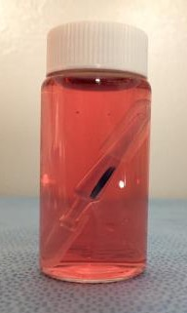
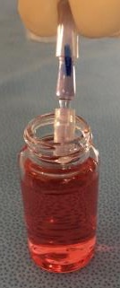
METHODS
Twenty seven cadaveric corneas
Prepared for DMEK using a standardized technique
Loaded in Straiko Modified Jones Tube injector
Stored with silicone caps covering each end

Slide 16
METHODS
Corneas divided into three groups of nine
Group 1—Preloaded prestained DMEK Graft (psDMEK)
Pre-stained with Trypan Blue 0.06% (DORC International) for 3 minutes prior to preloading and storage in the modified jones tube for 24 hours
Group 2—Preloaded DMEK Graft (pDMEK)
Directly preloaded in the injector prior to storage for 24 hours
Group 3—Immediately Injected DMEK Graft (Control)
Immediately injected into vital dye
Notes:
A statistically significant difference in ECL is felt to be 10%, based on the assumption that the mean endothelial cell loss in standard Eye-bank preparation of tissue is 22.5%.⁴
With a significance of 0.05 and a power of 0.9, 9 corneas will be needed in each group

Slide 17
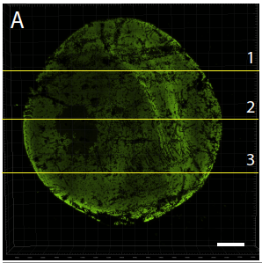
RESULTS
Notes:
3 dimension projection image of calcein AM vital dye stained cornea.
C. Cross sections through the adjacent full cornea image showing the undulations of the tissue on the z axis. The numbered lines in A represent the XZ cross sections in C. Scale bars = 1 mm.

Slide 18
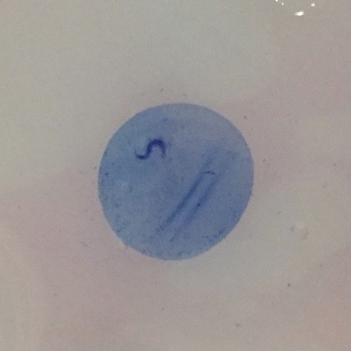
RESULTS
Appearance of preloaded and prestained DMEK tissue after 24 hours of storage

Slide 19
RESULTS
Table 1. Endothelial Cell Loss (%)*
 | Preloaded prestained DMEK Grafts (Group 1) | Preloaded DMEK Grafts (Group 2) | Immediately Injected DMEK Grafts-Control (Group 3)
Average (SD) | 16.78 (7.11) | 20.16 (7.52) | 18.47 (6.36)
Range | 6.86—32.27 | 12.81—33.29 | 10.27—30.50
p-value | 0.67 | 0.57 | REF

Slide 20
CONCLUSION
DMEK tissue can be stored in Optisol GS within the Straiko Modified Jones Tube for 24 hours without increased ECL
Prestaining DMEK tissue with Trypan Blue 0.06% prior to preloading does not result in increased ECL
DMEK Grafts retain sufficient blue coloration after 24 hours

Slide 21
Surgical Technique

Slide 22
PURPOSE
Pilot study to assess feasibility and efficacy of pre-loaded corneal donor grafts for Descemet Membrane Endothelial Keratoplasty

Slide 23
Methods
Prospective study
Eye bank pre-stripped, pre-stained, pre-trephined donor tissue
Outcome measures
Primary endpoints: rates of detachment, primary graft failure, rebubbling
Secondary endpoint: specular microscopy at 3 months

Slide 25
RESULTS
14 eyes of 13 patients
Follow up: 7 weeks (1 week to 3 months)
Primary Endpoints
Detachment: 4/14 (28.6%)
Rebubble: 1/14 (7.1%)
Primary graft failure: 0/14
Secondary Endpoints
Specular at 3 months:
Mean ECD 2530 (-11.4%)

Slide 26
Complications
CME: 1/14 (ERM)
Pupillary block: 1/14

Slide 27
Summary
Pre-stripped, pre-stained, pre-loaded DMEK (p3DMEK) may be a safe and efficacious alternative

Slide 28
Training Resources
www.eversightvision.org/onlinetraining
Journal articles, tissue prep options, demonstration videos and more

Slide 29
Questions?

